Slide 1

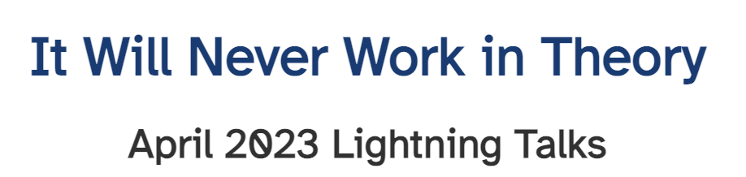
You Asked For It: Making Sense of User Feedback
Associate Professor Rashina Hoda
rashina.hoda@monash.edu @agileRashina

Slide 3

‘User Stories’ - an Agile Myth
A made-up story about what we think the users want
Based on assumptions
Led by convenience
No real users
No real stories
As a user I want to provide my own feedback So that customers don’t have to pretend to know what I need
Notes:
User stories are a common way to gain user feedback

Slide 4



Real User Stories are Priceless
Important source of identifying
Bugs
Usability Issues
New feature ideas
Customers pay for the development of the product, but users decide the fate of the product.

Slide 5


Real User Stories are Priceless
Important source of understanding
User needs generalizability
User wants personalisation

Slide 6
Real User Stories are Priceless
Important source of generating business value
Actioning user feedback
trust, loyalty, reputation
sales

Slide 7
How do we get the real user stories?

Slide 8




Proactive Stories
User Ratings
User Reviews on App Stores
User Feedback through Websites
User Complaints through Call Centers

Slide 9


Automatic Stories
User Activity Logs
User likes, dislikes, engagement
User Demographics

Slide 10
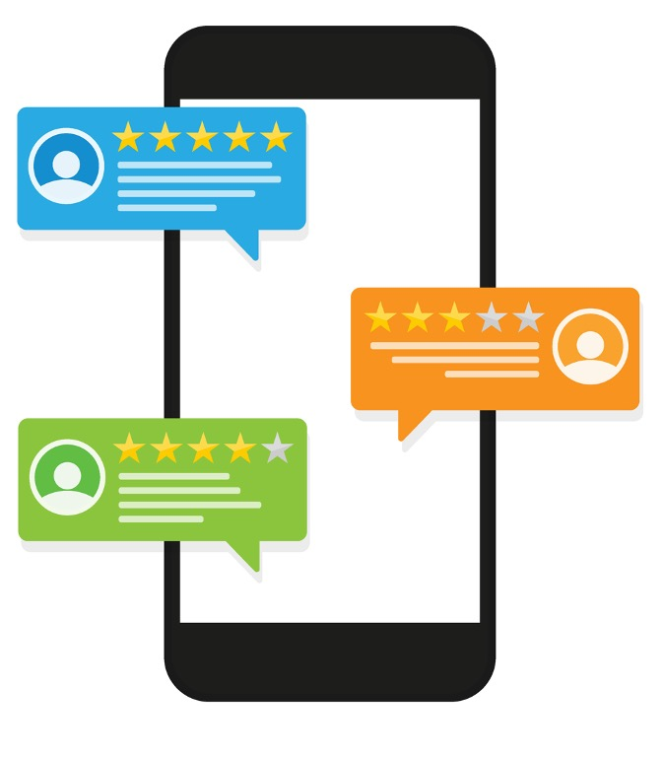
Prompted Stories
In-app User Ratings
In-app User Reviews

Slide 11





Elicited Stories
Co-design
User experience sessions
Focus groups
Observations
Interviews
Surveys
Think Aloud
Beta testing
Quasi experiments

Slide 12

What are we really dealing with?
Proactive
User ratings
User feedback forms on websites
User complaints through feedback form, call centre,..
Automatic
Usage activity logs
User characteristics
Prompted
User ratings in-app
Elicited
User experience sessions
Focus groups
Observations
Interviews
Surveys
Beta testing
Quasi experiments
Think Aloud
Co-design
User reviews on app stores
User reviews in-app
Large Scale
Qualitative Data
Small Scale

Slide 13


We don’t want to deal with real user feedback – Why?
I am here!
There’s lots of it!
It’s unstructured, messy
It’s hard work

Slide 14
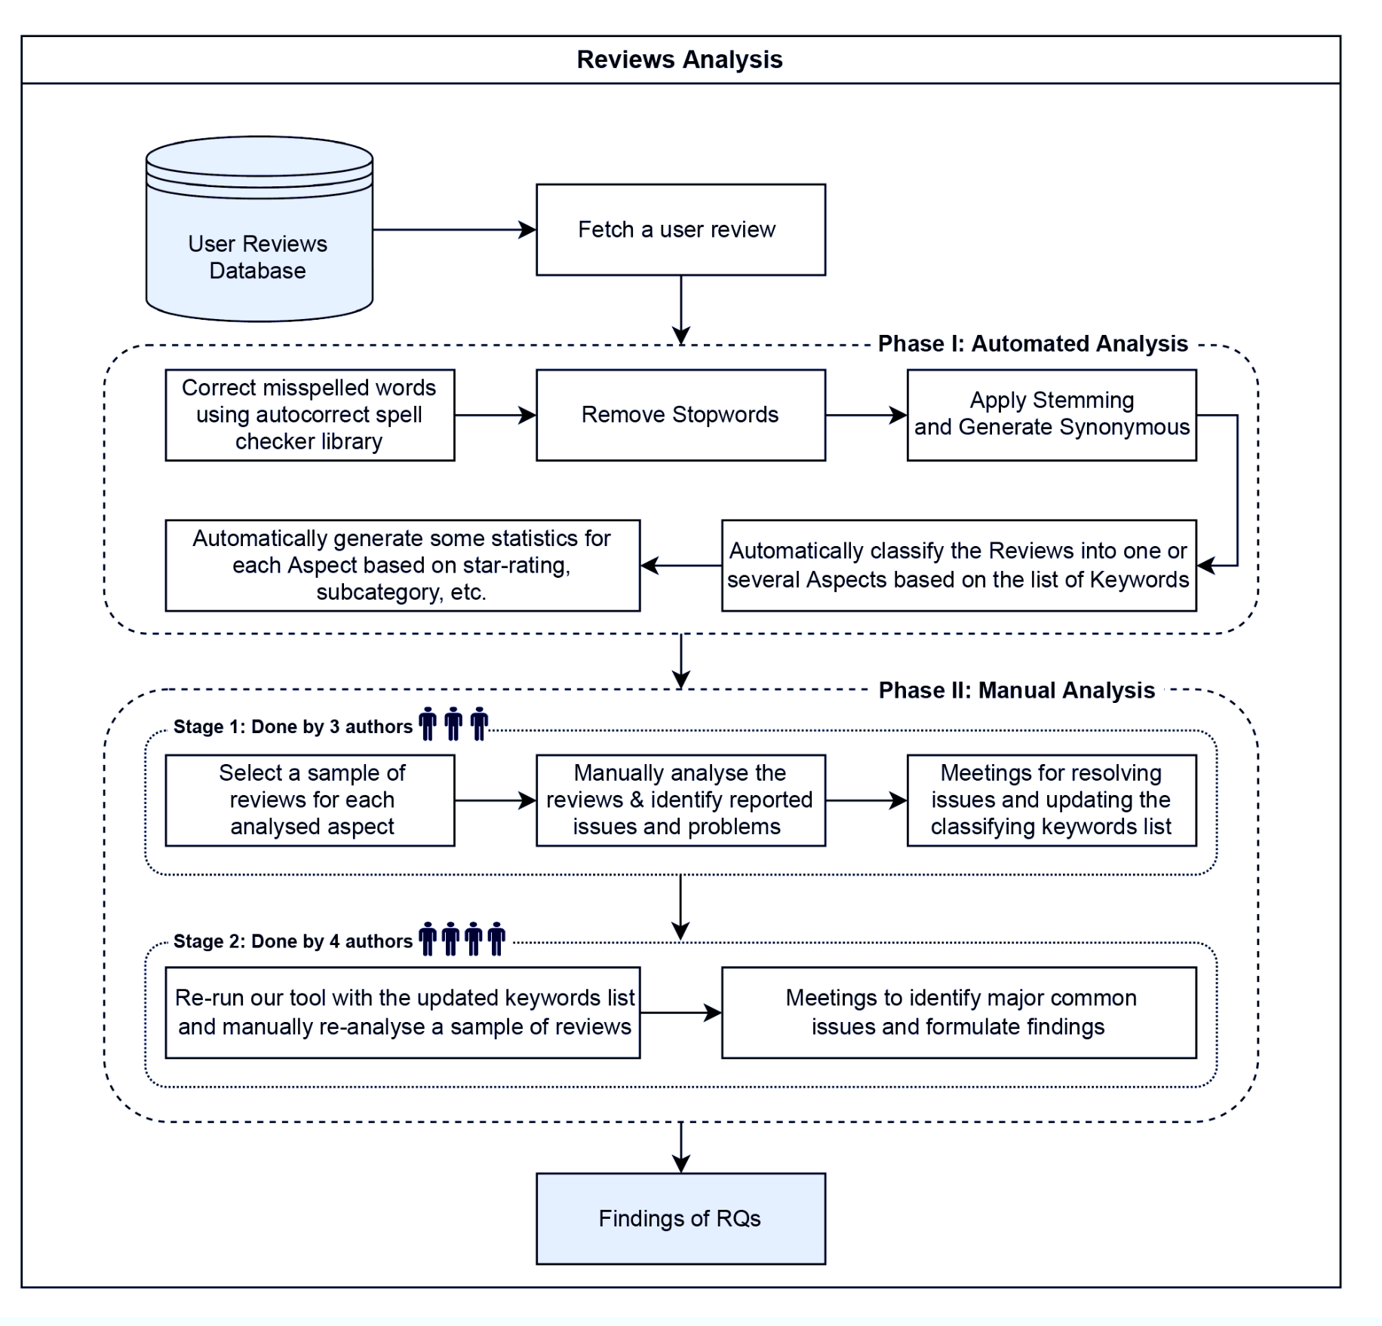
Current Approach
1
Automated Analysis
Filter noise
Apply synonyms
Classification based on keywords
2
Manual Analysis
Qualitative data analysis of sample reviews
Haggag, O., Grundy, J., Abdelrazek, M., & Haggag, S. (2022). A large scale analysis of mHealth app user reviews. Empirical Software Engineering, 27(7), 196.

Slide 15



Current Limitations
Need to find a
Helps answer what’s and how’s but not the why’s
If we only focus on the bugs, we will miss the butterflies
Competitors can find the butterflies even if we don’t

Slide 16
Socio-Technical Grounded Theory (STGT) – as a Powerful Qualitative Data Analysis Method
R. Hoda, "Socio-Technical Grounded Theory for Software Engineering," in IEEE Transactions on Software Engineering, vol. 48, no. 10, pp. 3808-3832, 1 Oct. 2022, doi: 10.1109/TSE.2021.3106280.

Slide 17




Open Coding in STGT – think Hashtags!
#scam
#multipleContactChannels
#unintentionalUpgrade
#noCustomerService
“Very frustrated, pro version is scam I’ve had this app for about a month or so. I unintentionally upgraded to the pro version ($99.00) because I had my fingerprint set with the App Store. I called the company phone number listed on my visa statement, only to hear a recorded voice. You’re then told to go to iTunes.com/bill regarding charges, then the call dies. After going to the site, you run into another dead end. AllTrails has zero customer service. I’ve yet to talk to a person from company.”
#poorReview

Slide 18
STGT - Constant Comparison & Abstraction
RAW DATA
CODES
CONCEPT
…App REQUIRES you to have Location Services always on …
#forcedLocationSharing
…You have no option than to give them consent to sell your data to third parties…
#PrivacyIssues
#forcedConsent2Policy
…my account got hacked and another phone was registered …
#hackedAccount

Slide 19


STGT for Qualitative Data Analysis
Enables systematic analysis of qualitative data
Individual classifications
Dataset-wide patterns
Rich insights, guidelines, recommendations (e.g. on improving Privacy)
More rigorous application can lead to…
Taxonomies
Theoretical models, theories, …

Slide 20
New Approach – Making sense of Real User Stories using STGT
Breadth
Automated Analysis
Filter noise
Apply synonyms
Classification based on keywords
Relevant Raw Data
Refined Keywords
Manual Analysis using STGT
Qualitative data analysis of sample reviews
Depth

Slide 21




Benefits for Software Teams
Smaller, classified piles of user feedback to work with
Richer analysis to draw out interesting findings
Catch the bugs
No missing the butterflies
Surprising Insights
Bugs
Ideas

Slide 22
Benefits for Users
Increased confidence in updating apps
Better ratings
Actioning user feedback
Benefits for Companies
trust, loyalty, reputation
sales

Slide 23
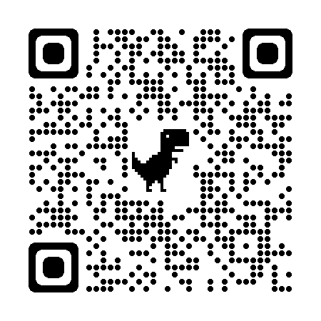
#STGT - Find Out More
STGT Guidelines
Technical Briefing
Upcoming Talk #ICSE2023
Upcoming Book
Thanks to Dr Omar Haggag & Michael Hoye
www.rashina.com/stgt

